Slide 1
Graph Evolution Networks lecture-9 Course on Graph Neural Networks (Winter Term 20/21)
Prof. Dr. Holger Giese (holger.giese@hpi.de)
Christian Medeiros Adriano (christian.adriano@hpi.de) - “Chris”
Sona Ghahremani (sona.ghahremani@hpi.de )

Slide 2
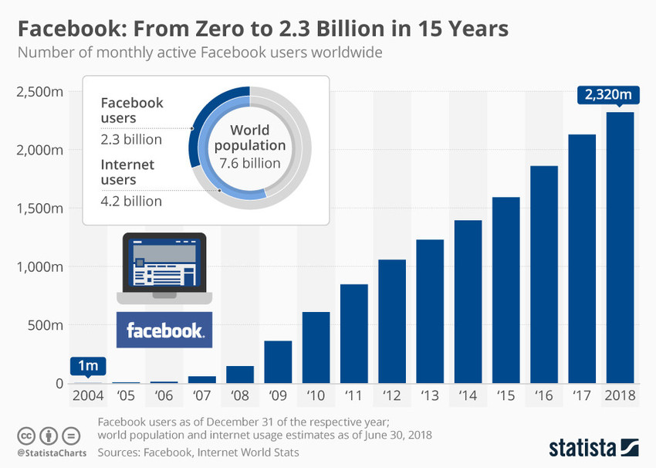
Evolving Networks
Almost all networks evolve by adding or removing links and node
Social Networks
Emails
News Comments
Product Evalutions

Slide 3
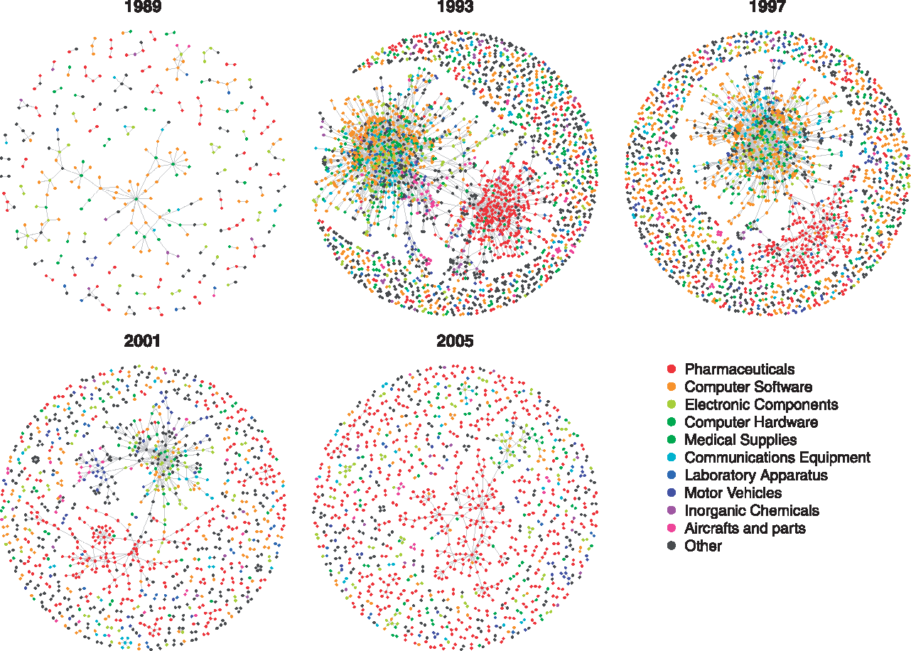

Figure 1. Evolution of the pooled R&D network. Pooled R&D network snapshots in 1989, 1993, 1997, 2001, and 2005. To ...
Evolution of the pooled R&D network
Notes:
Figure 1. Evolution of the pooled R&D network. Pooled R&D network snapshots in 1989, 1993, 1997, 2001, and 2005. To ease the visualization, we only plot the nodes belonging to the 10 largest sectors and their alliance partners.
Unless provided in the caption above, the following copyright applies to the content of this slide: © The Author 2016. Published by Oxford University Press on behalf of Associazione ICC. All rights reserved.

Slide 4
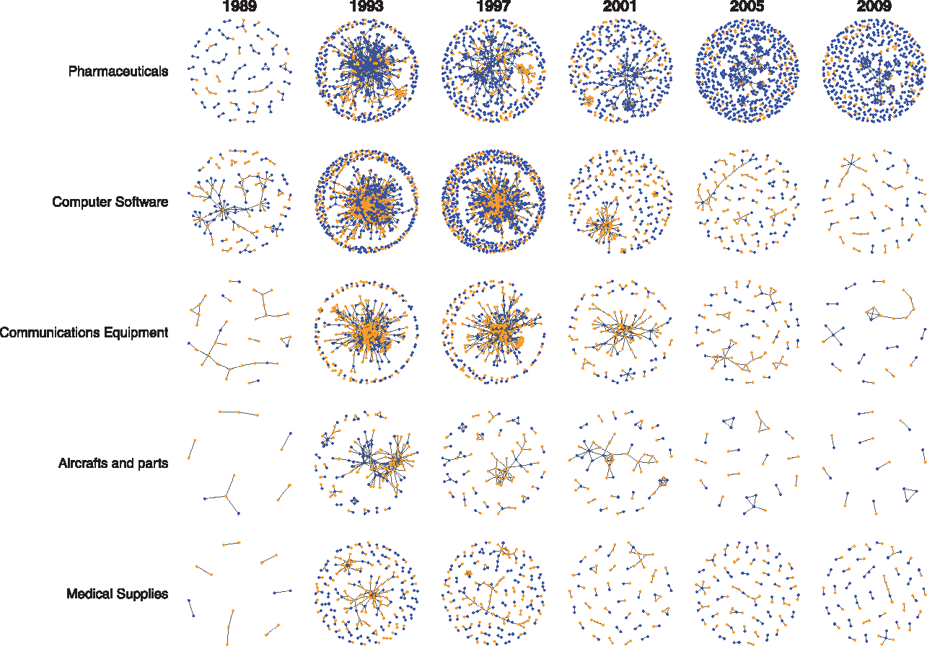
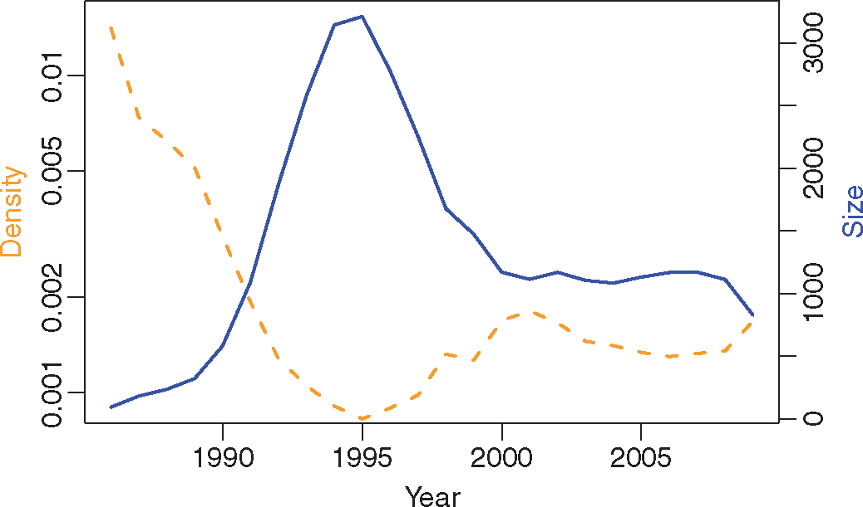
Figure 2. Evolution of five selected sectoral R&D networks. Snapshots in 1989, 1993, 1997, 2001, 2005, and 2009 for ...
Evolution of the pooled R&D network
Figure 3. Size and density evolution of the pooled R&D network. Time-evolution of size (solid line, right y-axis) and ...
Notes:
Figure 2. Evolution of five selected sectoral R&D networks. Snapshots in 1989, 1993, 1997, 2001, 2005, and 2009 for five selected sectoral R&D networks: Pharmaceuticals, Computer Software, Communication Equipment, Aircrafts and parts, Medical Supplies. Blue nodes represent the firms strictly belonging to the examined sector, while orange nodes represent their alliance partners belonging to different sectors.
Unless provided in the caption above, the following copyright applies to the content of this slide: © The Author 2016. Published by Oxford University Press on behalf of Associazione ICC. All rights reserved.

Slide 5
Quick recap – Where are we now?
Graph Metrics and Random Models
Graph Classification - Clustering
Graph Sampling - Random Walks
Graph Embeddings - Message Passing
PageRank
Graph Structure Learning
Graph Convolutional Networks
Graph Attention Networks
Graph Evolution Networks
Graph Generative Models
Network Effects and Cascading Behavior
Probabilistic Contagion Models
Outbreak Detection in Networks
Influence Maximization in Networks
Design concerns
Understand a phenomenon
Extract features
Stablish baselines
Preprocessing data
Description models
Predict an outcome
ML architecture and pipeline
Training models
Evaluation models
Prediction models
Effects of interventions
Risks of confounding
Causal structure
Intervention models
Notes:
[Wang & Tax 2016] Wang, Feng, and David MJ Tax. "Survey on the attention based RNN model and its applications in computer vision." arXiv preprint arXiv:1601.06823 (2016).
[Luong et al. 2015] Luong, Minh-Thang, Hieu Pham, and Christopher D. Manning. "Effective approaches to attention-based neural machine translation." arXiv preprint arXiv:1508.04025 (2015).
[Vaswani et al. 2017] Vaswani, A., Shazeer, N., Parmar, N., Uszkoreit, J., Jones, L., Gomez, A. N., ... & Polosukhin, I. (2017). Attention is all you need. Advances in neural information processing systems, 30, 5998-6008.
Bahdanau, Dzmitry, Kyunghyun Cho, and Yoshua Bengio. "Neural machine translation by jointly learning to align and translate." arXiv preprint arXiv:1409.0473 (2014).
Xu, Kelvin, et al. "Show, attend and tell: Neural image caption generation with visual attention." International conference on machine learning. 2015.
The research described in the paper Graph Convolutional Network (GCN), indicates that combining local graph structure and node-level features produces good performance on node classification tasks. However, the way GCN aggregates is structure-dependent, which can hurt its generalizability.
One workaround is to simply average over all neighbor node features as described in the research paper GraphSAGE. However, Graph Attention Network proposes a different type of aggregation. GAN uses weighting neighbor features with feature dependent and structure-free normalization, in the style of attention.

Slide 6
Why do we need Graph Evolution?
Time is a feature of nodes, edges, and graphs
Frequent versus stale relationships
Similarity or clustering w.r.t. time
Time itself is a characteristic to be predicted
Probability of links in time
Network events (contagion, influence) in time

Slide 7
Brief (incomplete) historical perspective
2000’s – Measuring network evolution phenomena
Growth dynamics of the world-wide web [Huberman & Adamic 1999]
Graphs over time densification laws, shrinking diameters and possible explanations [Leskovec et al. 2005]
The dynamics of viral marketing [Leskovec, Adamic & Huberman 2007]
2010’s – Generative models for network evolution
Kronecker graphs an approach to modeling networks [Leskovec et al. 2010]
Emerging topic detection on twitter based on temporal and social terms evaluation [Cataldi et al. 2010]
Collaboration over time characterizing and modeling network evolution [Huang et al. 2012]
2020’s – Prediction models of network evolution
Temporal Graph Neural Networks [Rossi et al. 2020]
Evolvegraph: Multi-agent trajectory prediction with dynamic relational reasoning [Li et al. 2020]
Spectral Temporal Graph Neural Network for Multivariate Time-series Forecasting [Cao et al. 2020]

Slide 8
Topics
Structural Evolution
Densification, Diameter Shrinking
Temporal Evolution Models
Community Model
Forest Fire Model
Temporal PageRank
Temporal Gaph Models (Next Lecture)

Slide 9
Structural Evolution

Slide 10
Macro Evolution
Proportion of number of nodes and edges over time
Change in diameter
Degree distribution
Connectivity
[1] https://en.wikipedia.org/wiki/Winograd_Schema_Challenge

Slide 11
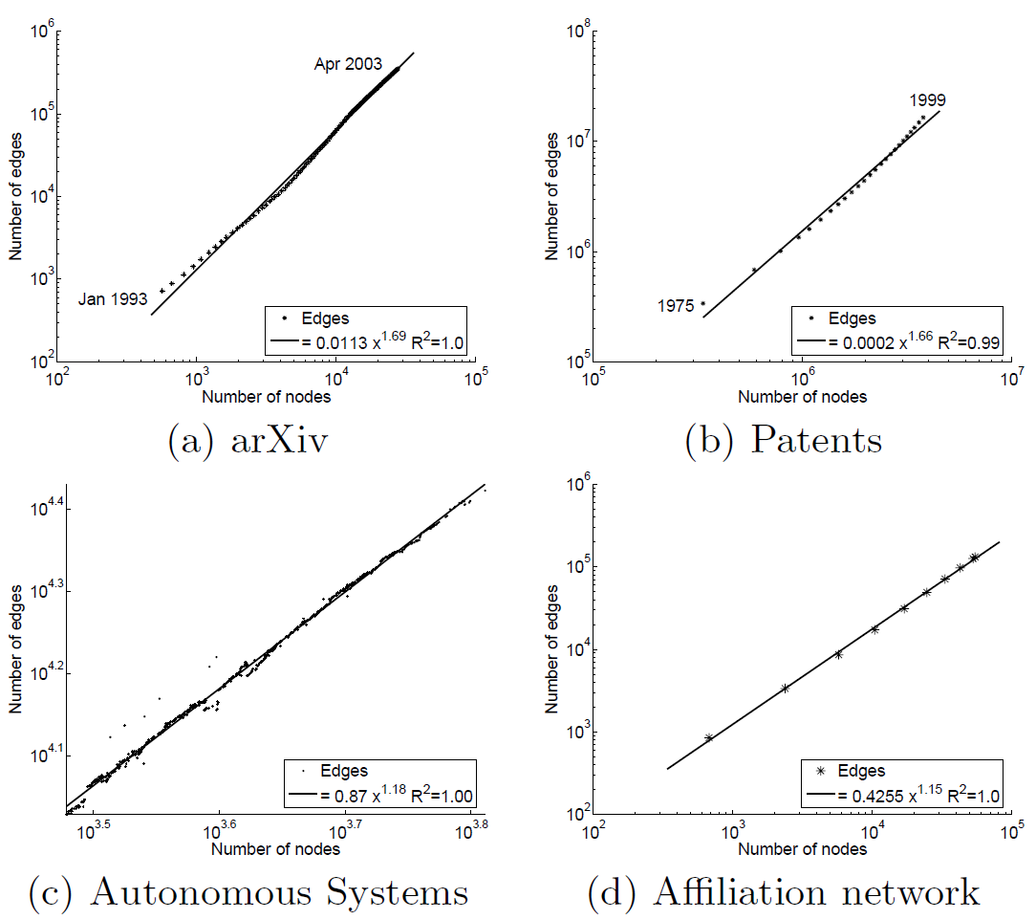
Evolution of Edges and Nodes Distribution
Exponential growth of nodes and edges
Leskovec, J., Kleinberg, J., & Faloutsos, C. (2005). Graphs over time: densification laws, shrinking diameters and possible explanations. In ACM KDD (pp. 177-187).

Slide 12
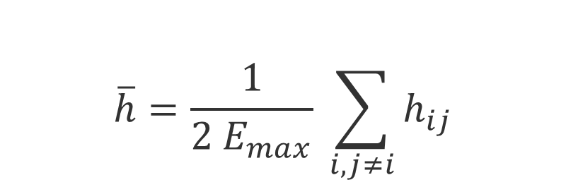
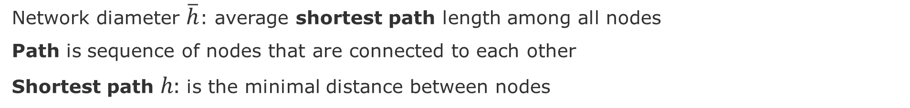
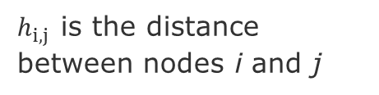
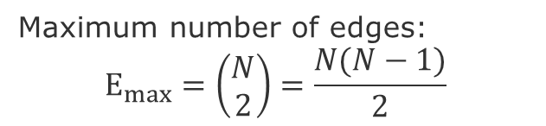
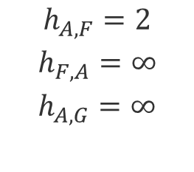
Network Diameter (or geodesic distance)
Network diameter $\overline{h}$: average shortest path length among all nodes
Path is sequence of nodes that are connected to each other
Shortest path $h:$ is the minimal distance between nodes
E
$$\overline{h}=\frac{1}{2 E_{max}} \sum_{i,j≠i}{h_{ij}}$$
A
F
B
H
C
G
D
Maximum number of edges:
$$E_{max}=\left(\begin{aligned}N \\ 2\end{aligned}\right)=\frac{N(N−1)}{2}$$
$$h_{A,F}=2$$
$$h_{F,A}=∞$$
$$h_{A,G}=∞$$
$h_{i,j }$is the distance between nodes i and j

Slide 13
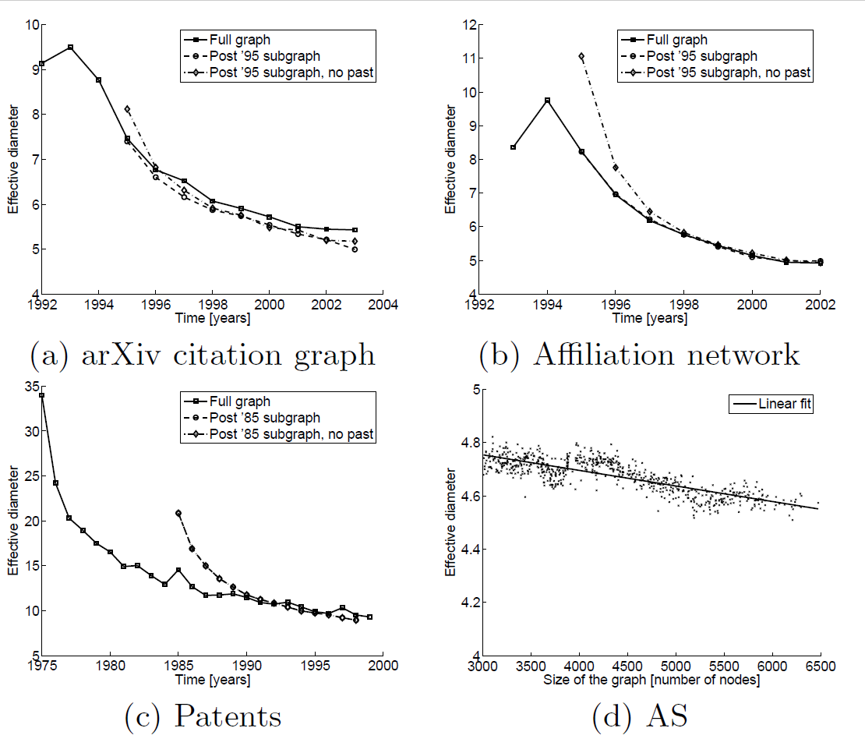
Evolution of Diameter
Leskovec, J., Kleinberg, J., & Faloutsos, C. (2005). Graphs over time: densification laws, shrinking diameters and possible explanations. In ACM KDD (pp. 177-187).

Slide 14
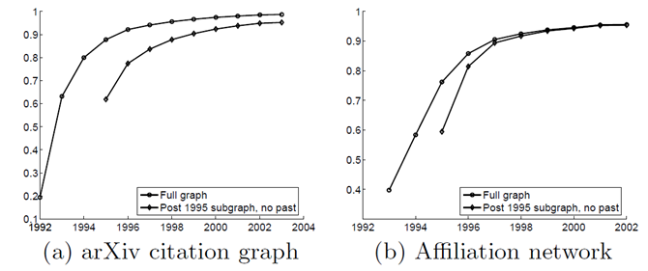
Evolution of Connectivity - Emergence of giant component
The fraction of the nodes that are part of the giant connected component over time.
After 4 years, 90% of all nodes are connected to the giant component.
Leskovec, J., Kleinberg, J., & Faloutsos, C. (2005). Graphs over time: densification laws, shrinking diameters and possible explanations. In ACM KDD (pp. 177-187).

Slide 15
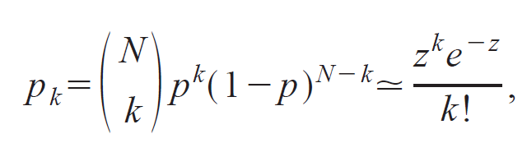
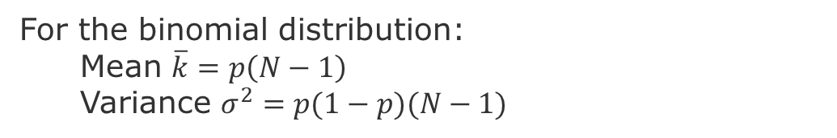
Random Graph – Distribution of Node Degree
Distribution of Node Degrees
z = average number of edges
k = degree of an edge
In the limit when N is very large. i.e., a Poisson distribution
For the binomial distribution:
Mean $\overline{k}=p\left(N−1\right)$
Variance $σ^{2}=p(1−p)(N−1)$
Newman, Mark EJ, Steven H. Strogatz, and Duncan J. Watts. "Random graphs with arbitrary degree distributions and their applications." Physical review E 64.2 (2001): 026118.
Notes:
Poisson Distribution = probability of a given number of events occurring in a fixed interval of time or space if these events occur with a known constant mean rate and independently of the time since the last event

Slide 16
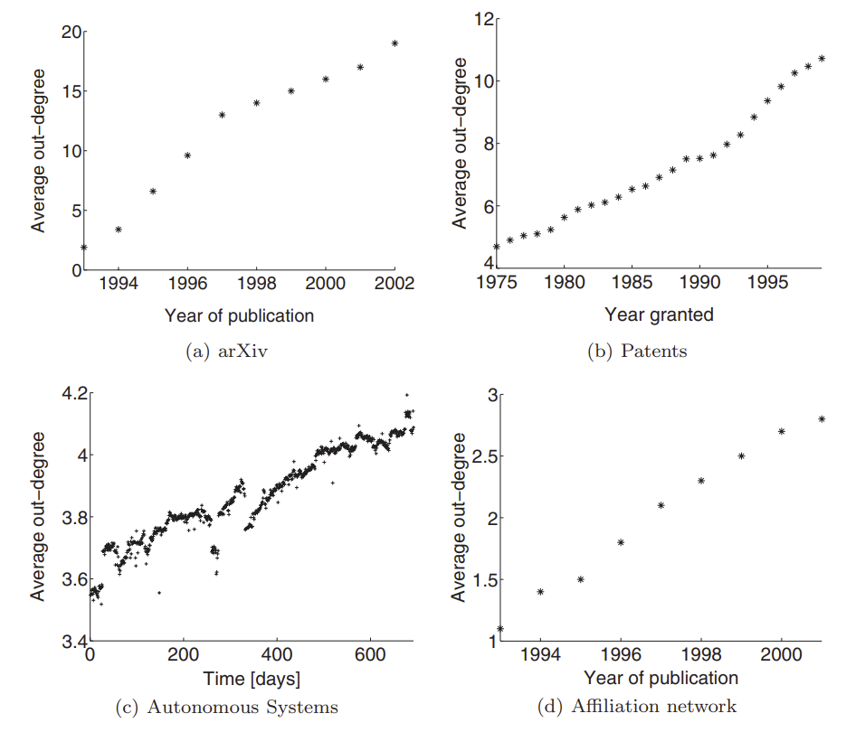
Evolution of Average degree - Densification
Linear growth of average out-degree
Leskovec, J., Kleinberg, J., & Faloutsos, C. (2007). Graph evolution: Densification and shrinking diameters. ACM transactions on Knowledge Discovery from Data (TKDD), 1(1)
Notes:
Autonomous systems graph –
The graph of routers comprising the Internet can be organized
into sub-graphs called Autonomous Systems (AS).
Each AS exchanges traffic flows with some neighbors (peers).
We can construct a communication network of who-talks-towhom
from the BGP (Border Gateway Protocol) logs.
We use the the Autonomous Systems (AS) dataset from [26].
The dataset contains 735 daily instances which span an interval
of 785 days from November 8 1997 to January 2 2000.
In contrast to citation networks, where nodes and edges
only get added (not deleted) over time, the AS dataset also
exhibits both the addition and deletion of the nodes and
edges over time.

Slide 17
Evolution Models

Slide 18

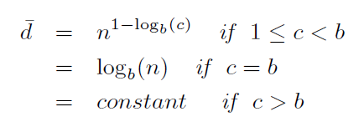
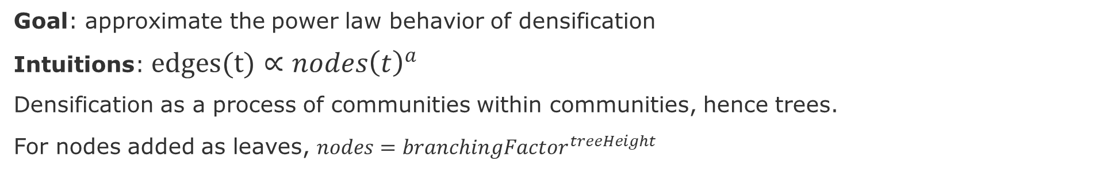
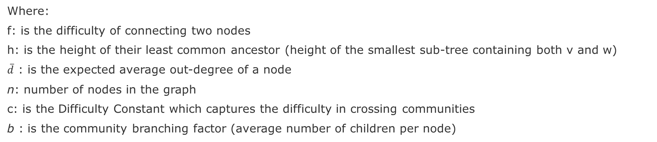
Community Guided Attachment Model
Goal: approximate the power law behavior of densification
Intuitions: $edges(t)∝nodes{\left(t\right)}^{a}$
Densification as a process of communities within communities, hence trees.
For nodes added as leaves, $nodes=branchingFactor_{ }^{treeHeight}$
Where:
f: is the difficulty of connecting two nodes
h: is the height of their least common ancestor (height of the smallest sub-tree containing both v and w)
$\overline{d}$ : is the expected average out-degree of a node
n: number of nodes in the graph
c: is the Difficulty Constant which captures the difficulty in crossing communities
b : is the community branching factor (average number of children per node)
Leskovec, J., Kleinberg, J., & Faloutsos, C. (2005). Graphs over time: densification laws, shrinking diameters and possible explanations. In ACM KDD (pp. 177-187).

Slide 19
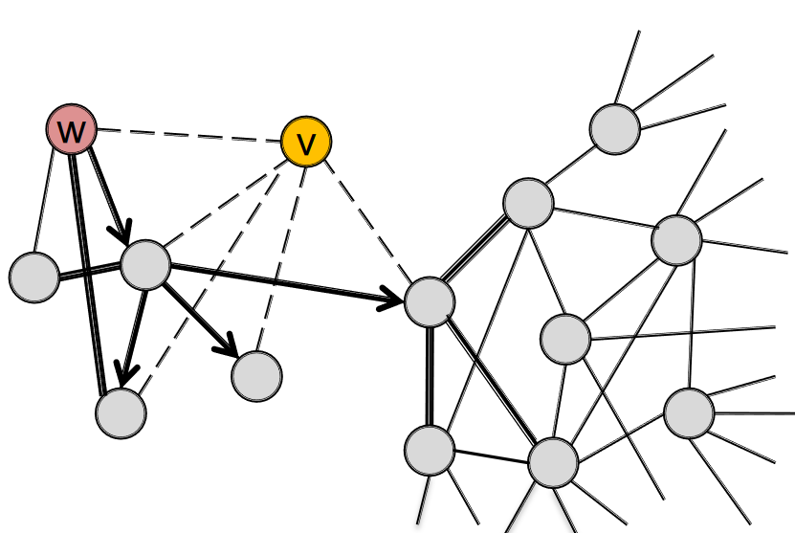
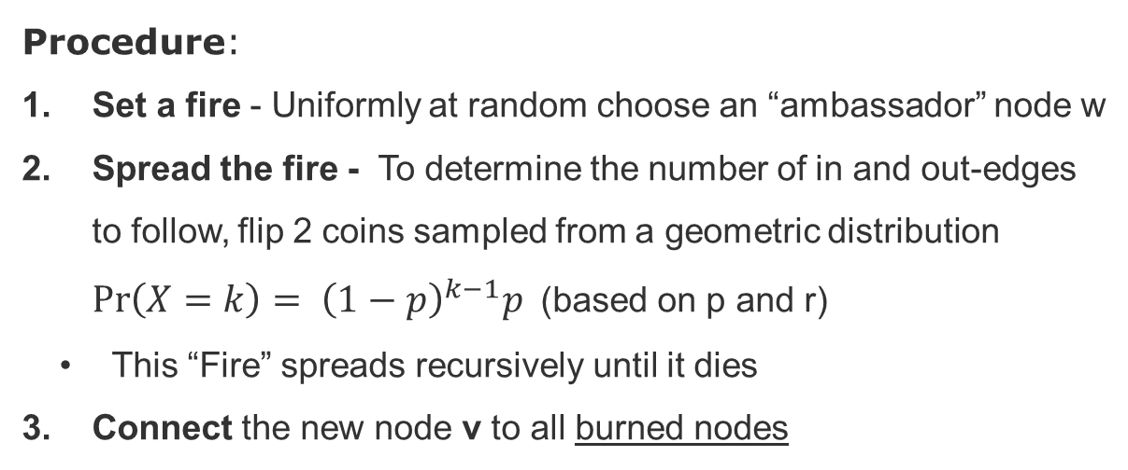
Forest Fire Model
Goal: generate graphs that densify and have shrinking diameters
Intuition: create new connections by generate a recursive cascade in the graph
Ambassador node
New node
Procedure:
Set a fire - Uniformly at random choose an “ambassador” node w
Spread the fire - To determine the number of in and out-edges to follow, flip 2 coins sampled from a geometric distribution $\operatorname{Pr}\left(X=k\right)= {\left(1−p\right)}^{k−1}p$ (based on p and r)
This “Fire” spreads recursively until it dies
Connect the new node v to all burned nodes
Source: https://web.stanford.edu/class/cs224w/slides/16-evolution.pdf
Notes:
Source: https://web.stanford.edu/class/cs224w/slides/16-evolution.pdf

Slide 20
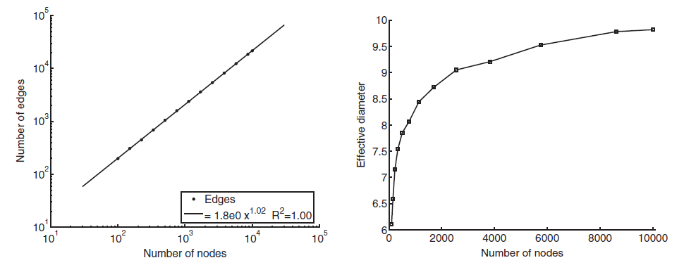
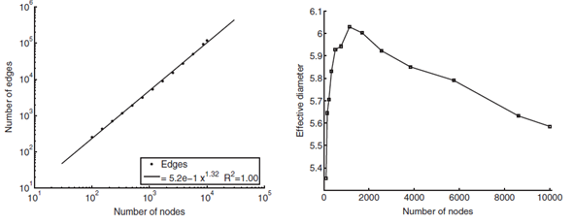
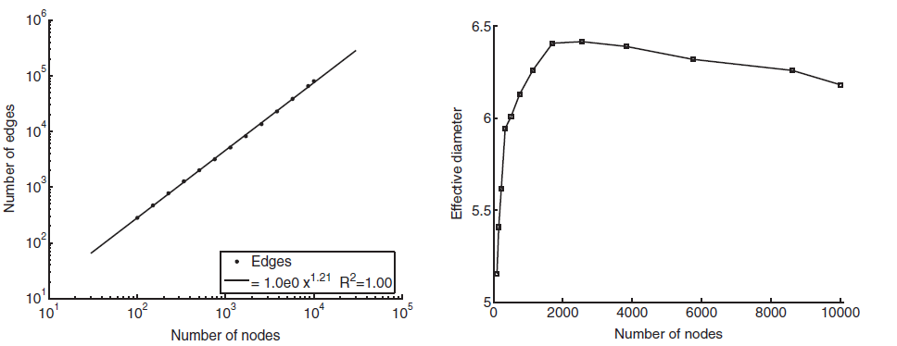
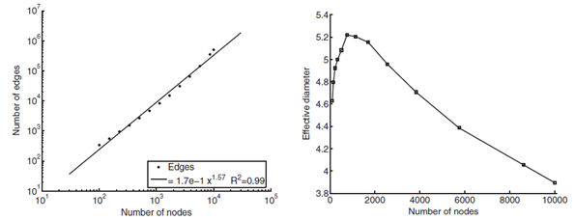
Forest Fire Results - # of edges and Effective Diameter
Effective Diameter
Effective Diameter
sparse graph (a =1.01 < 2), with increasing diameter (forward-burning probability: p = 0.35, backward probability: pb = 0.20)
densifying graph ((a = 1.32 < 2) with decreasing diameter (p = 0.37, pb = 0.33)
densifying graph (a = 1.21 < 2) with slowly decreasing
diameter (p = 0.37, pb = 0.32).
dense graph with densification exponent close to 2 (a = 1.57) and decreasing diameter (p = 0.38, pb = 0.35).
Source: https://web.stanford.edu/class/cs224w/slides/16-evolution.pdf

Slide 21
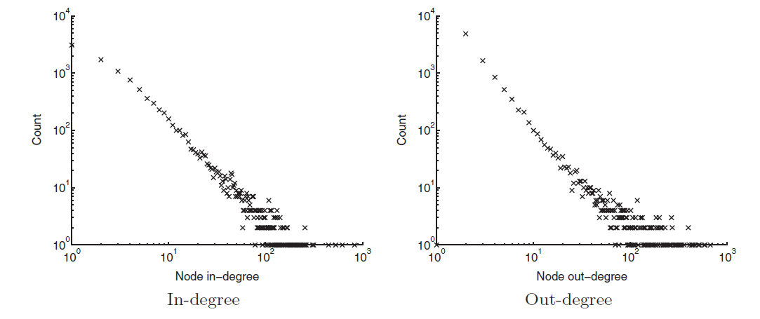
Forest Fire also generates Power law distributions
Degree distribution of a sparse graph with decreasing diameter (forward-burning probability: 0.37, backward probability: 0.32).
Leskovec, J., Kleinberg, J., & Faloutsos, C. (2007). Graph evolution: Densification and shrinking diameters. ACM transactions on Knowledge Discovery from Data (TKDD), 1(1)

Slide 22
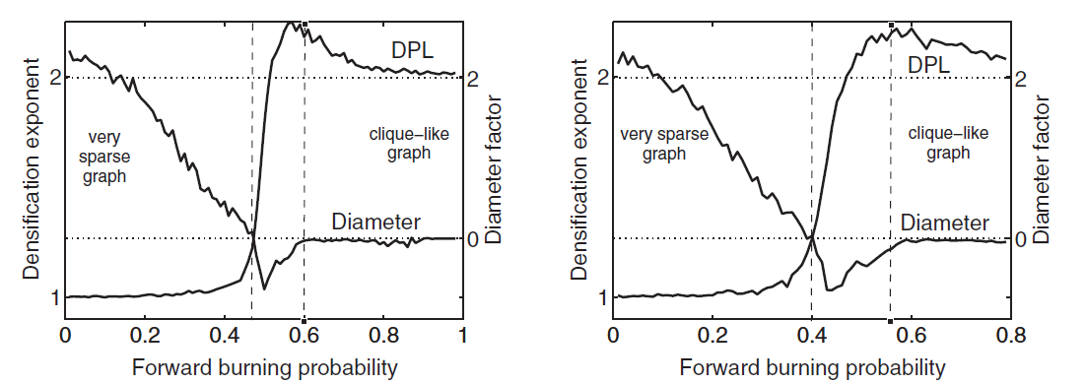
Forest Fire Sweet spot
fix burning ratio, r = 0.5 and vary forward-burning probability p
fix backward-burning probability pb= 0.3 and vary forward-burning probability p
Leskovec, J., Kleinberg, J., & Faloutsos, C. (2007). Graph evolution: Densification and shrinking diameters. ACM transactions on Knowledge Discovery from Data (TKDD), 1(1)
Notes:
fix burning ratio, r = 0.5 and vary forward-burning probability p
fix backward-burning probability pb= 0.3 and vary forward-burning probability p

Slide 23
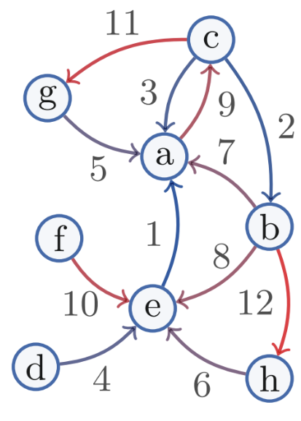
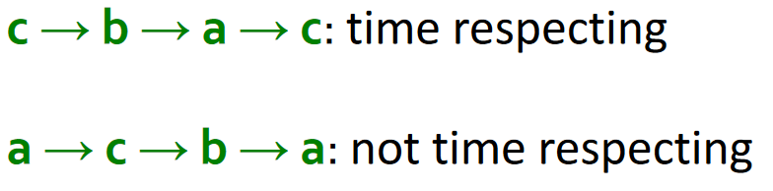
Temporal Page Rank
Goal: Make a random walk only on temporal or time-respecting paths
Intuition: Run a regular PageRank on a time-augmented graph
Time stamps increase along the path
Edge timestamps
https://web.stanford.edu/class/cs224w/slides/16-evolution.pdf

Slide 24
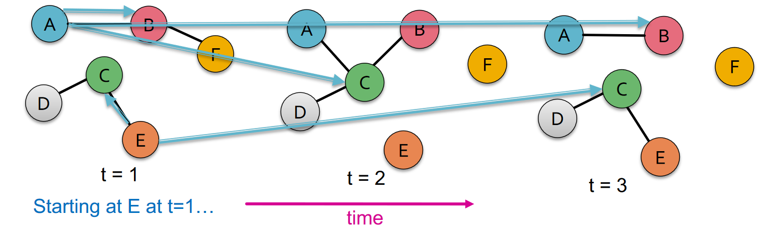
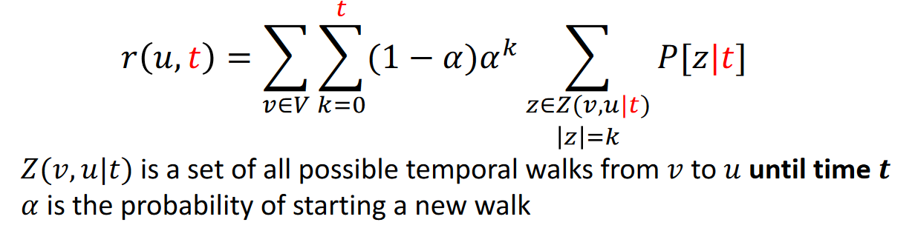
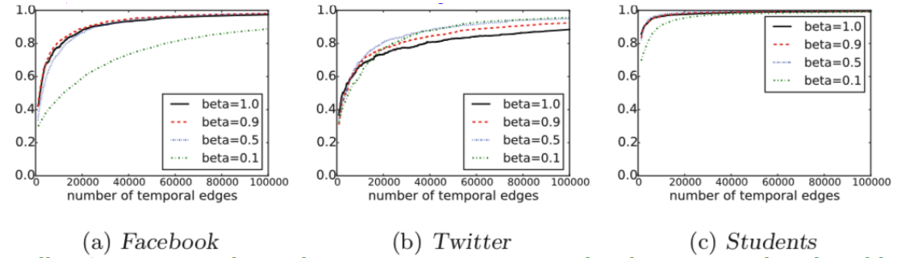
Temporal PageRank – Augmented Graph
Rank quality (Pearson corr. coeff. Between static and temporal PageRank) and transition probability 𝜷
𝑟(𝑢): Temporal PageRank estimate of 𝑢
Smaller 𝜷 corresponds to slower convergence rate, but better correlated rankings
24
https://web.stanford.edu/class/cs224w/slides/16-evolution.pdf
Notes:
Rank quality (Pearson corr. coeff. Between static and temporal PageRank) and transition probability 𝜷
Smaller 𝜷corresponds to slower convergence rate, but better correlated rankings

Slide 25
Next: Temporal Graph Models
Temporal Graph Neural Networks [Rossi et al. 2020]
EvolveGraph: Multi-agent trajectory prediction with dynamic relational reasoning [Li et al. 2020]
Spectral Temporal Graph Neural Network for Multivariate Time-series Forecasting [Cao et al. 2020]
Suggestions?
Notes:
https://junyanz.github.io/CycleGAN/
increase the size of im-ages the model can process in practice,

Slide 26
Next and Future Tasks
Compute and compare graph metrics (Wednesday, 2.12)
Any metrics and networks of your choice
First draft of abstract (Friday, 4.12)
Predictions using traditional method (Wednesday, 9.12)
Any two methods of your choice
Related work draft (Friday, 11.12)
Node and Graph Feature Learning (Wednesday, 16.12)
Any two methods of your choice
Design alternative pipelines for your GNN (Wednesday, 06.01)
Three alternative with different options for embedding, aggregation, and enconding
Test at least one.

Slide 27
END

